Slide 1
Abaqus Python
Abaqus Python Scripting
Learn with the concepts
Lec 1 – What is Abaqus Python

Slide 2
Content:
What is python
Why learn python as an Abaqus user
How to run Python Scripts
How to access Abaqus Python Interface
Example scripts

Slide 3
What is python?
Everything in python is an “object” – Object Orientated Language.
Attributes
Method
Attributes:
Name
Step Number
nlgoem
Attributes:
Height
Age
Profession
Step
Methods:
getFrame
frames
setDefaultField
Methods:
Running
Working
odb.steps[‘step-1’].frames[1].fieldOutputs[‘U’].values[0].data

Slide 4
What is python?
No pre-compiling required.
Write the code
Compile
Use/Run it
Licensed/Free
No variable declaration required.
It is very simple, easy to learn. It is close to human readable language.
Code modules and/or packages can be imported which tremendously increase usability.

Slide 5
Why learn Python as an Abaqus user?
Use python functionality to interact with underlying Abaqus data structure.
Python provides a vehicle to extend out-of-box functionality.
With python you can:
Automate repetitive pre- and post-processing tasks.
Mathematically post-process FE data.
To create new GUI options and thereby increasing the utilization of Abaqus in terms of usability.
To do parametric study

Slide 6
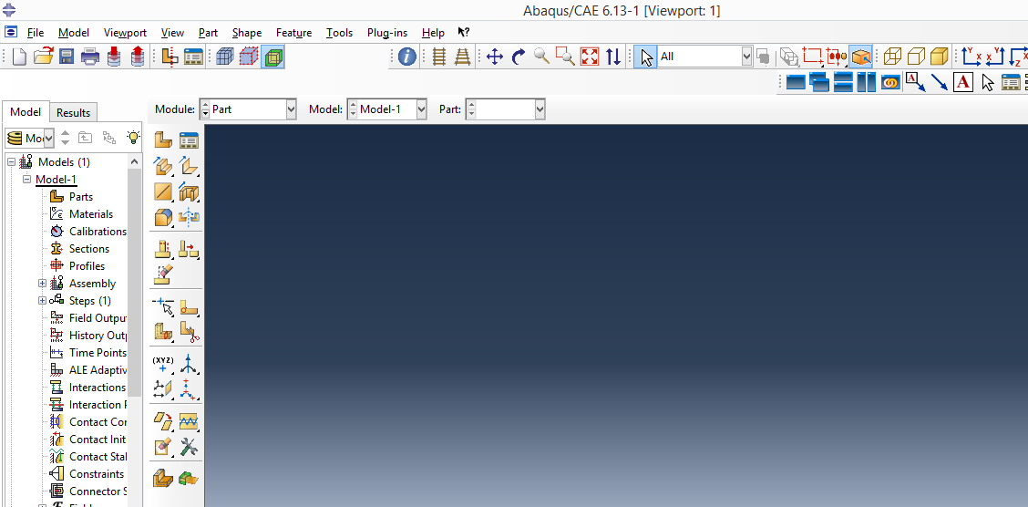
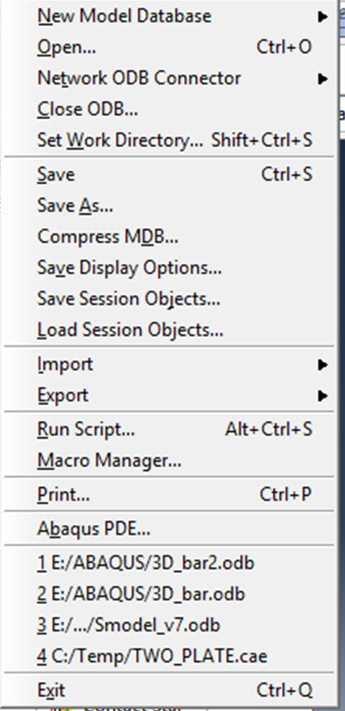
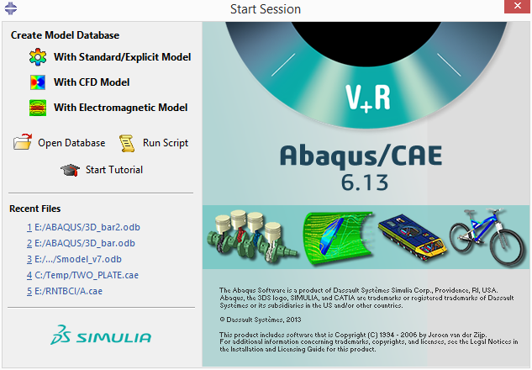
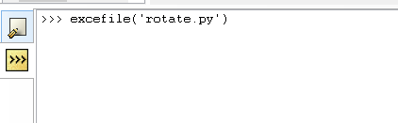
How to run python scripts
Command Line Interface

Slide 7
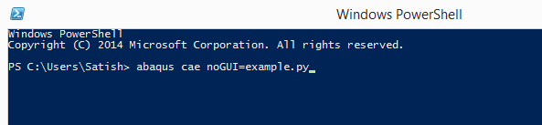
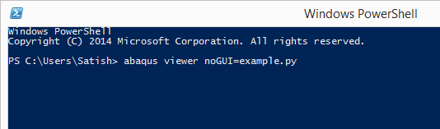
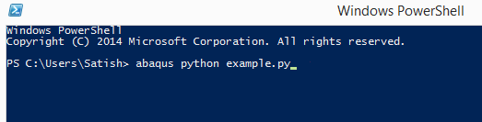
How to run python scripts
Does NOT need Abaqus license

Slide 8
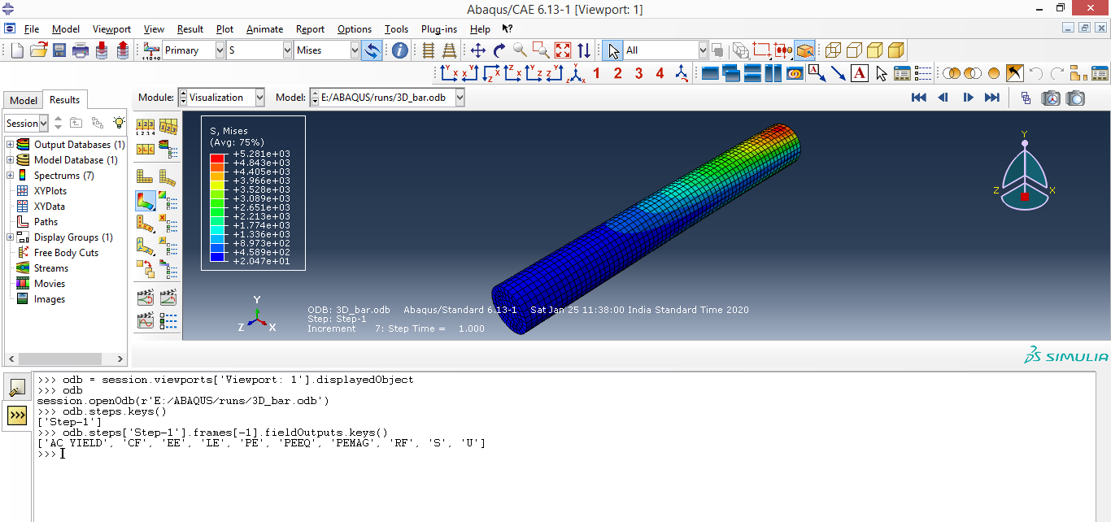
How to run or access python interface

Slide 9
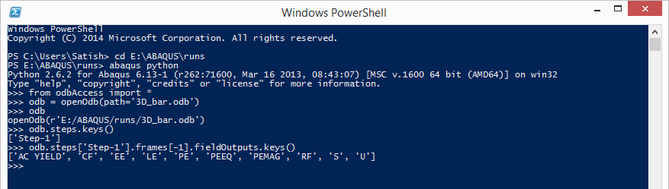
How to run or access python interface

Slide 10
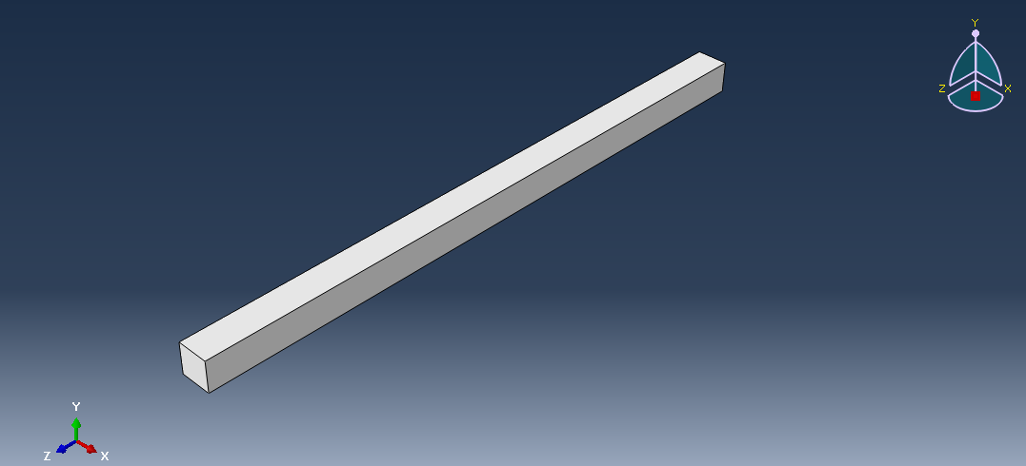
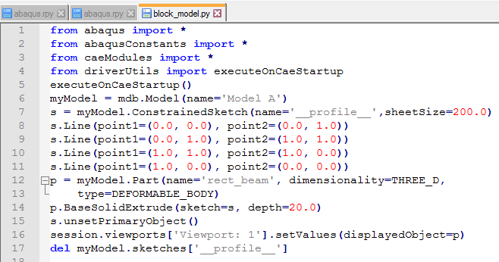
Example Script 1:
Module import
Create model
Create sketch object
Drawing model sketch
Creating part object
Extruding sketch to get the part
Setting part to the viewport

Slide 11
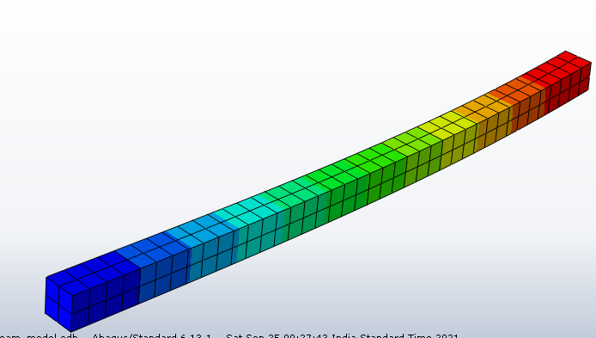
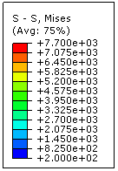
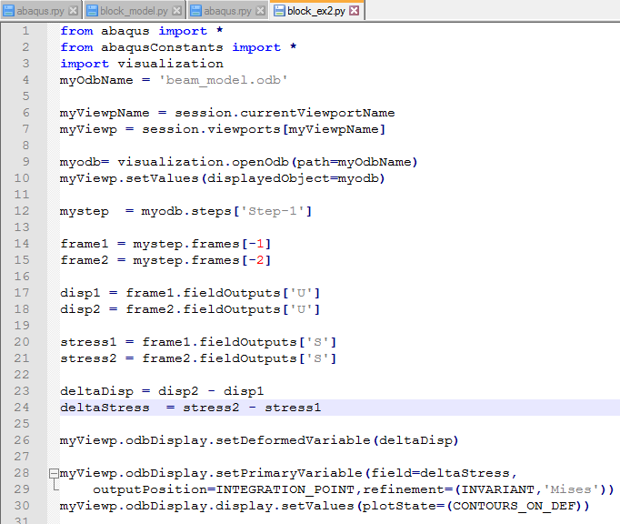
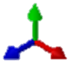

Example Script 2:
Module import
Opening the ODB
Accessing the “Step-1” step from the ODB
Accessing the frames from “Step-1” step
Accessing the displacement field output
Y
Accessing the stress field output
Z
X
Manipulating the data
Plotting the contour for the new data

Slide 12
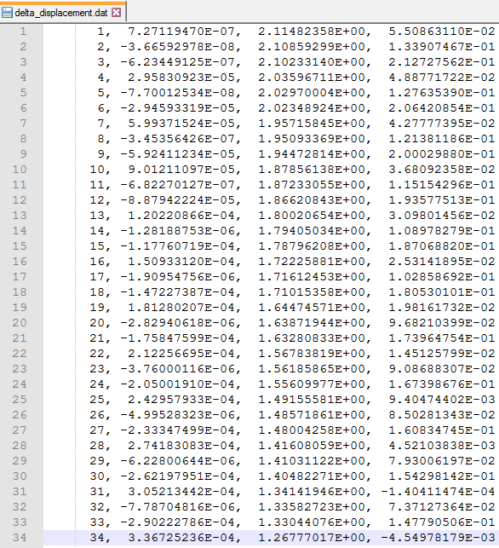
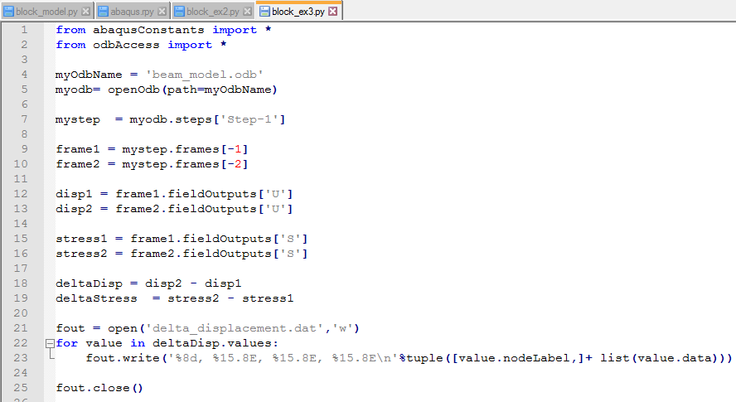
Example Script 3:
Module import
Opening the ODB
Accessing the “Step-1” step
Accessing the frames from “Step-1” step
Accessing the displacement field output
Accessing the stress field output
Manipulating the data
Saving the data to a text file

Slide 13
Next Session
Lec 2 – Abaqus object model
What are the Abaqus object model
Different types of Abaqus object model
What is session Abaqus object model
What is MDB Abaqus object model
What is ODB Abaqus object model
How to use them effectively

